Slide 1
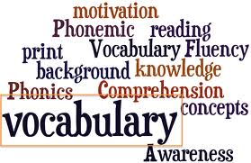
Story #19
Reading Story Vocabulary
R6.A.2.1.2: Identify and apply meaning of content specific words used in text.

Slide 2
abandoned a-ban-doned

Slide 3
beloved be-loved

Slide 4
demolished dem-ol-ished

Slide 5
eager eager

Slide 6
humongous hu-mong-ous

Slide 7
neglected ne-glect-ed

Slide 8
severe sev-ere

