Slide 1
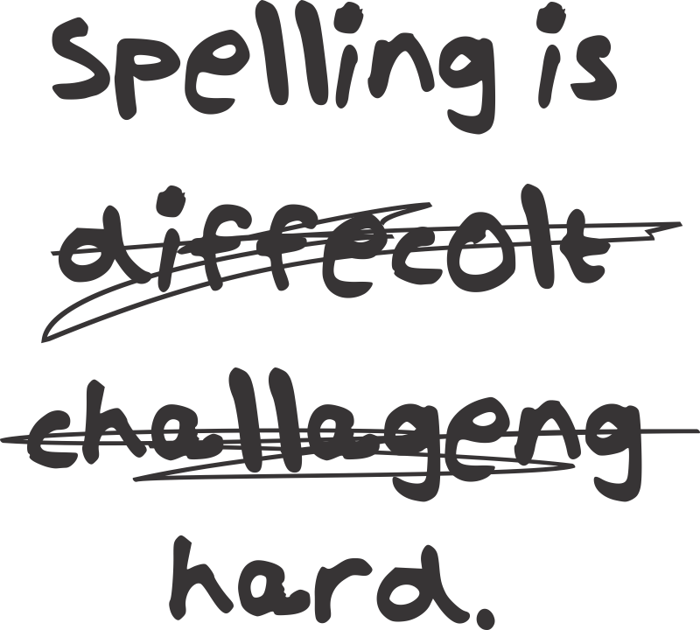
Spelling
Lesson 2 – Vowels and Vowel Digraphs
E05.D.1.2.5: Spell grade-appropriate words correctly.

Slide 2
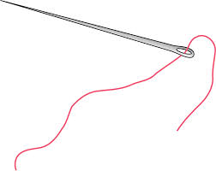
needle nee-dle

Slide 3
speech spee-ch

Slide 4
reason rea-son

Slide 5
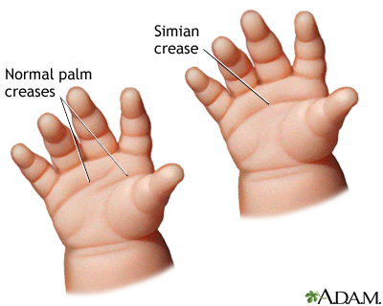
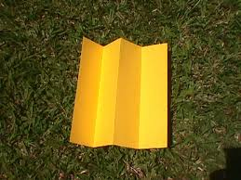
crease crea-se

Slide 6
thief thie-f

Slide 7
fade fa-de

Slide 8
obtain ob-tain

Slide 9
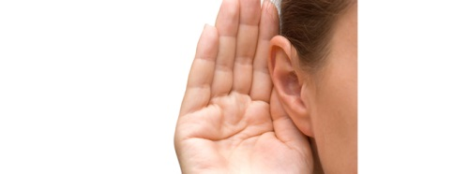
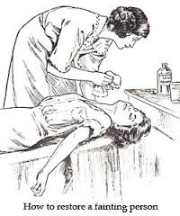
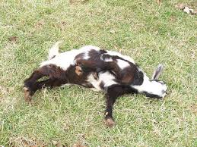
faint fain-t

Slide 10
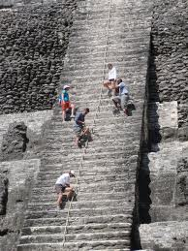
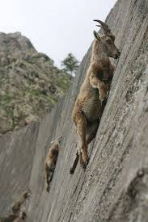
steep stee-p

Slide 11
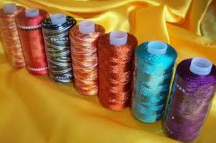
rayon ray-on

Slide 12
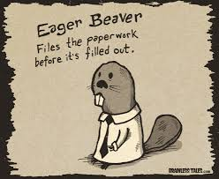
eager ea-ger

Slide 13
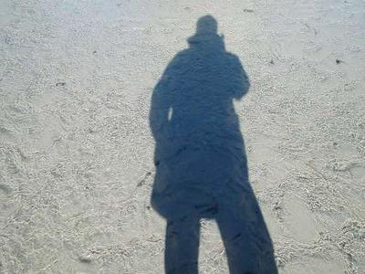
shadow sha-dow

Slide 14
saying say-ing

Slide 15
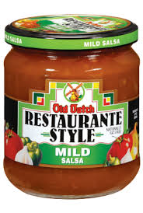
mild mi-ld

Slide 16
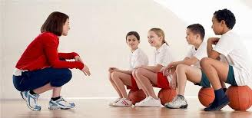
coach coa-ch

Slide 17
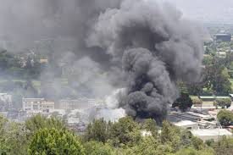
smoke smo-ke

Slide 18
twice twi-ce

Slide 19
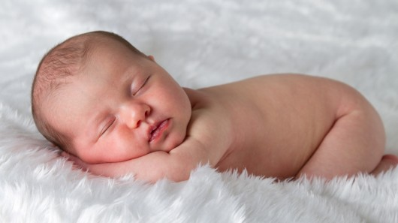
human hu-man

Slide 20
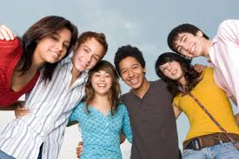
teenage teen-age

Slide 21
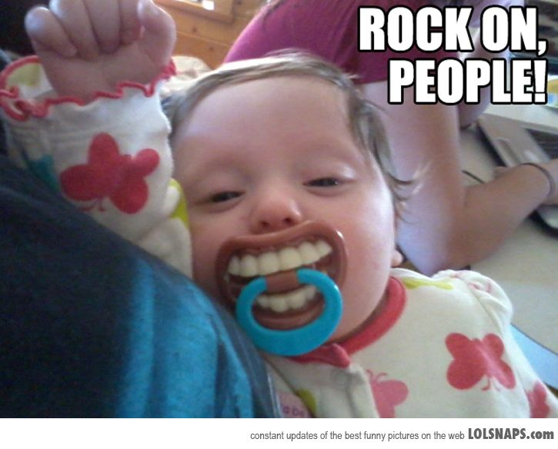
niece nie-ce

