Slide 1
The Volunteers
Reading Story Vocabulary
R6.A.2.1.2: Identify and apply meaning of content specific words used in text.

Slide 2
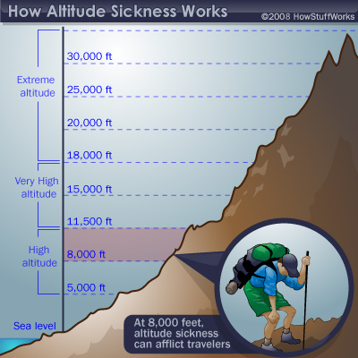
altitude alt-i-tu-de

Slide 3
equipped e-quip-ped

Slide 4
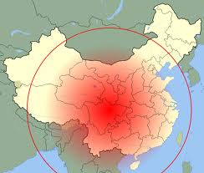
extent ex-ten-t

Slide 5
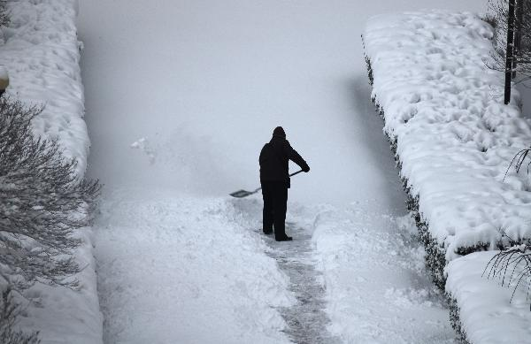
hampered ham-per-ed

Slide 6
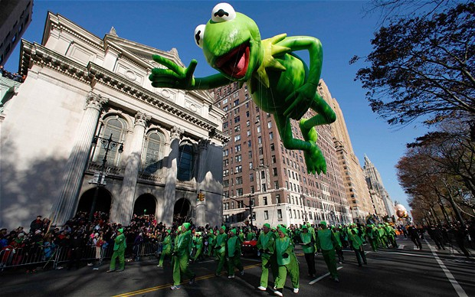
overshadowed
o-ver-shad-owe-d

Slide 7
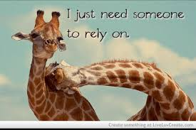
rely re-ly

Slide 8
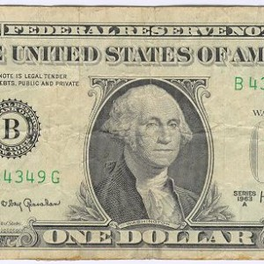
reserve re-ser-ve

