Slide 1
It Takes Two!
Reading Story Vocabulary
R6.A.2.1.2: Identify and apply meaning of content specific words used in text.

Slide 2
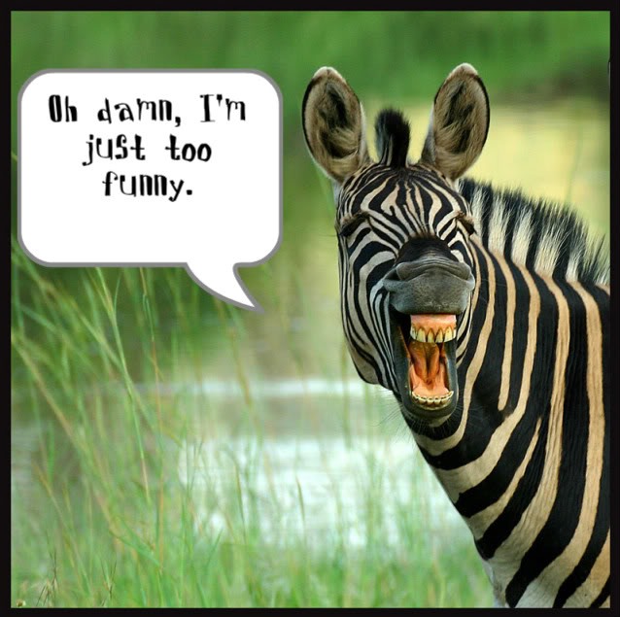
jest jest

Slide 3
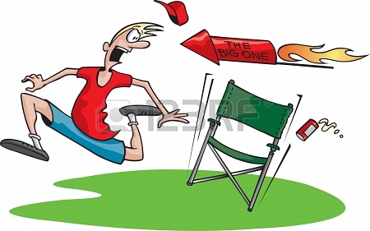
haywire hay-wire

Slide 4
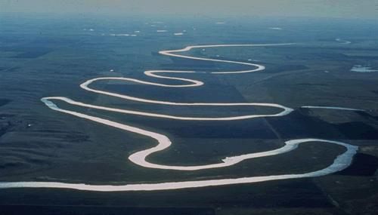
sinuous sin-u-ous

Slide 5
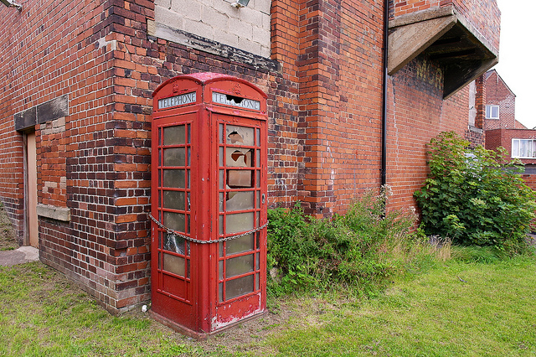
immobile im-mo-bile

Slide 6
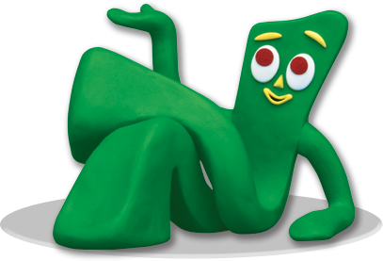
supple sup-ple

Slide 7
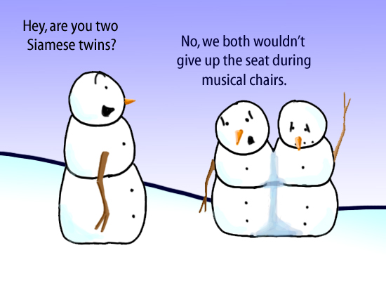
fused fu-sed

Slide 8
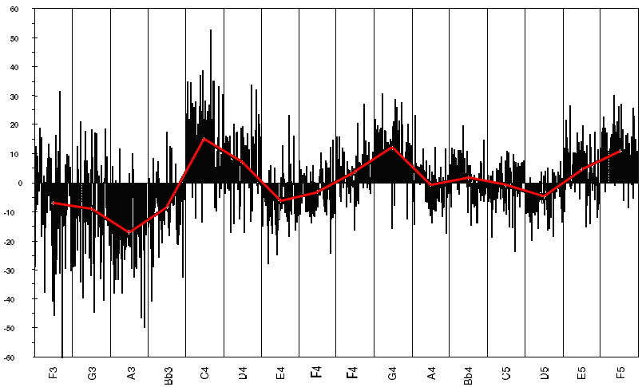
intonation in-to-na-tion

