Slide 1
VOCABULARY WORDS
TOM ADAMS
AND
SANTA ANA
R6.A.2.1.2: Identify and apply meaning of content specific words used in text.

Slide 2
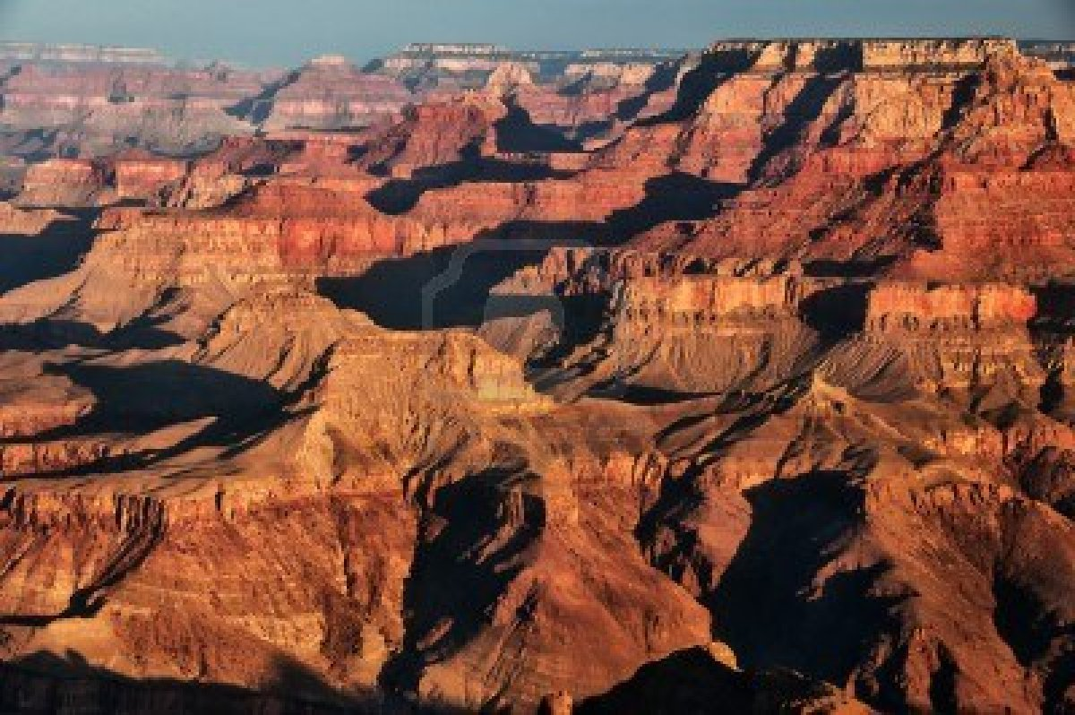
ASTOUNDING

Slide 3
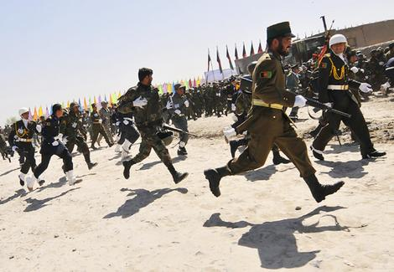
DISBANDED

Slide 4
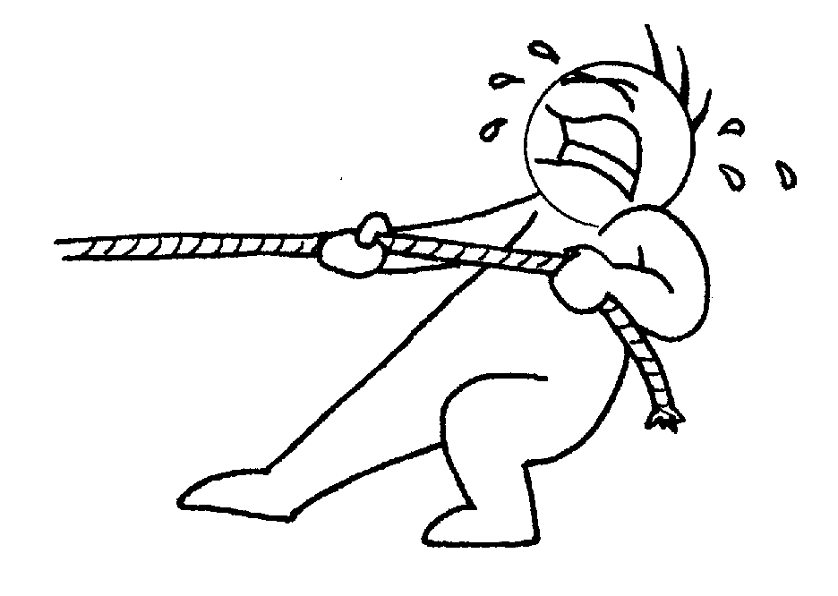
EXERTS

Slide 5
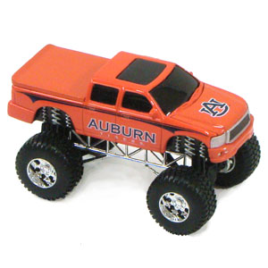
REPLICA

Slide 6
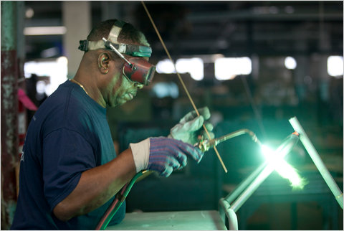
RIGGED

Slide 7
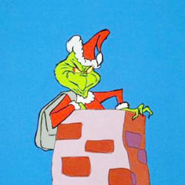
SCHEMES

Slide 8
STABILIZE

